Slide 1
Creational Patterns
Factory Method
Abstract Factory
Builder
Singleton
Object Pool

Slide 2
Factory Method

Slide 3
Synopsis
CreationRequester is independent of ConcreteProduct
  In Creation (Dynamically Add)
  In Use

Slide 4
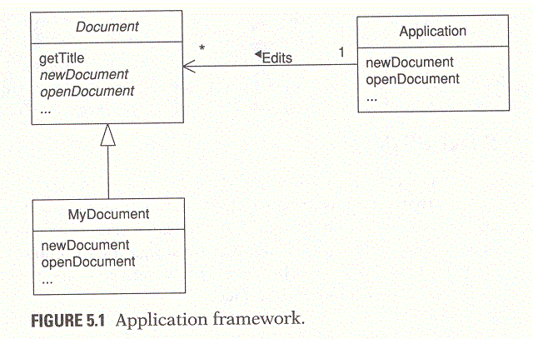
Context
Document Editor Framework

Slide 5
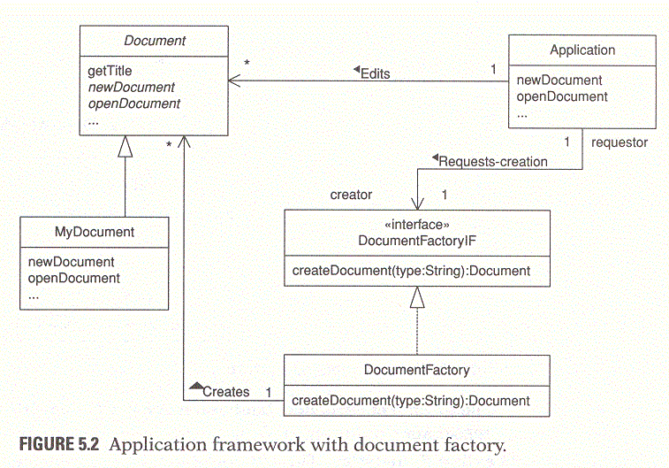
Context
Document Editor Framework

Slide 6
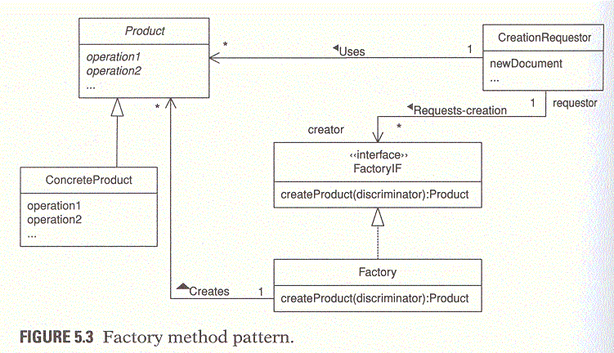
Solution
CreationRequester | FactoryIF-Factory | Product-ConcreteProduct

Slide 7
Key Points
CreationRequester is independent of ConcreteProduct
  In Creation (Dynamically Add)
    FactoryIF-Factory
  In Use
    Product-ConcreteProduct

Slide 8
Implementation Guideline
Factory Implementation
  Use Hashed Adaptor Objects for
  Use java.lang.reflect.Constructor Object as Key
  Do not use polymorphic method

Slide 9
Applications
(General) DocumentEditor | DocumentFactoryIF-DocumentFactory | Document-aDocument
(Java)URLConnection(getContent,createContenthandler, setContentHandlerFacotry) | ContentHandlerFactory | ContentHandler (getContent)-Contents
(Example) Socket-EncryptedSocket | EncryptionFactoryIF-EncryptionFactory | Encryption-DESEncryption

Slide 10
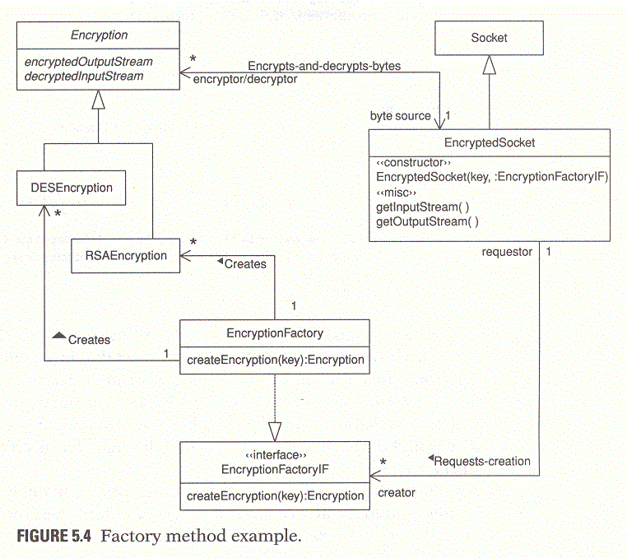
Encrypted-Socket Example

Slide 11
Related Patterns
Abstract Factory
Template Method
Prototype
Hashed Adaptor Objects: separate the selection logic from the data it uses to make the selection

Slide 12
Abstract Factory

Slide 13
Synopsis
Create instances of a set of related abstract classes

Slide 14
Context
User-Interface Framework that works on top of multiple windowing systems, such as MS-windows, Motif, MacOS
Platform’s native look and feel

Slide 15
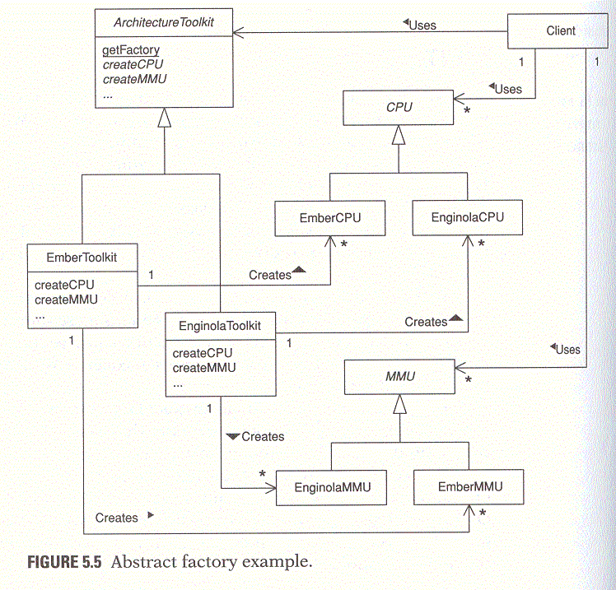
Example

Slide 16
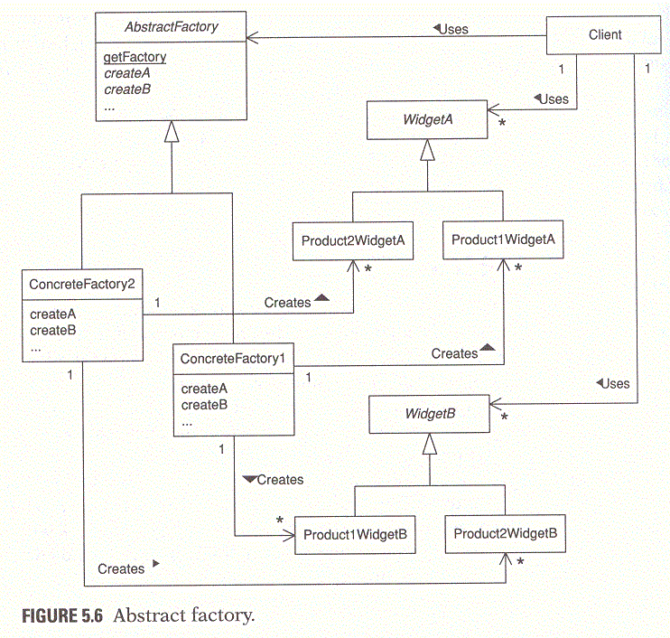
Solution
AbstractFactory-ConcreteFactory

Slide 17
Implementation Guideline
Static getFactory Method
Use Hashed Adaptor Objects in order to separate the selection logic from the data it uses to make the selection

Slide 18
Applications
Allowing a program to work with a variety of complex external entities
Different window systems with similar functionality
A program that perform remote diagnostics on computers for a computer manufacturer
java.awt.Toolkit

Slide 19
Builder

Slide 20
Synopsis
Client object constructs a complex object by specifying only its type and content
Client is shielded from the details of the object’s construction

Slide 21
Forces
To Produce multiple external representations of the same data
The class(es) responsible for providing content should be independent of any external data representations and the classes that build them
The classes responsible for building external data representations are independent of the classes that provides the content

Slide 22
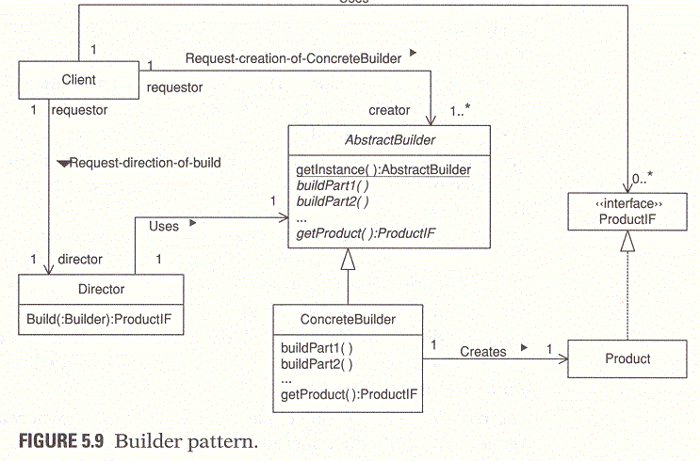
Solution
Client | Director | AbstractBuilder-ConcreteBuilder | ProductIF-Product

Slide 23
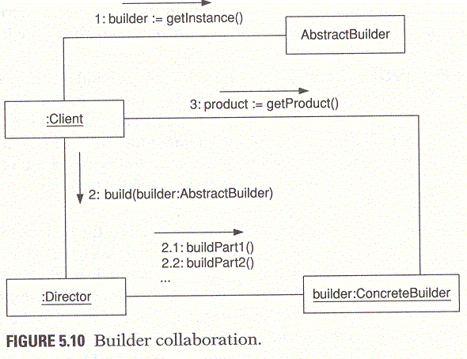
Solution

Slide 24
Context
Email gateway
  receives e-mail messages that are in MIME format and
  forwards them in a different format for a different kind of e-mail system

Slide 25
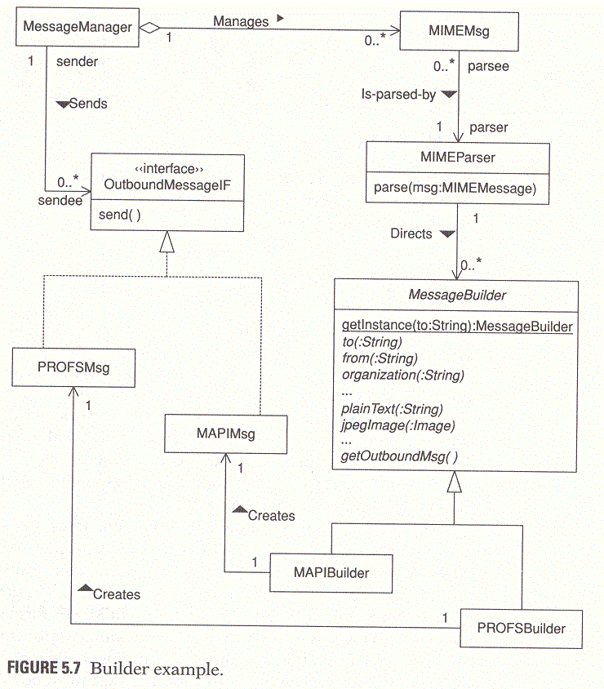
Context : Email Gateway

Slide 26
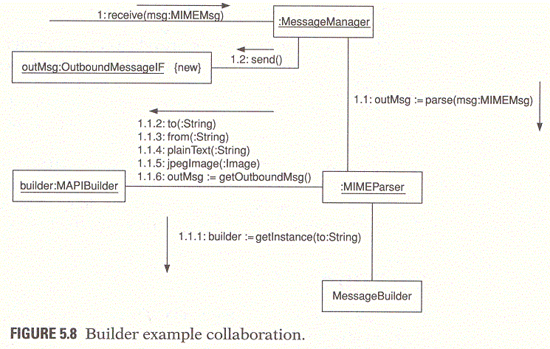
Context : Email Gateway

Slide 27
Key Points
Client is shielded from the details of the object’s construction -> Director
Client object constructs a complex object by specifying only its type and content
  Type -> to select ConcreteBuilder
  Content -> to build Product

Slide 28
Applications
Email Gateway =>
  Message Manager (MIMEMsg) | MIMEParser | MessageBuilder-MAPIBuilder | MsgIF-MAPIMsg

Slide 29
Singleton

Slide 30
Synopsis
To ensure that only one instance of a class is created
All objects that use an instance of that class use the same instance

Slide 31
Context
Examples
  Central Resource Manager
    Manager of DB connections
    Manager of error counter or performance statisitics
    Audio Clip Manager

Slide 32
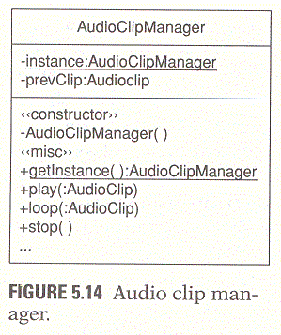
Example: Audio Clip Manager

Slide 33
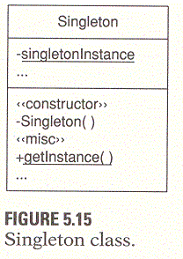
Solution

Slide 34
Solution
To has a static variable that refers to the one instance of the class that you want to use
To prevent other classes from creating any additional instances of a singleton class (-> all of the class’s constructors are private)
To access the one instance of a singleton class, the class provides a static method, typically called getInstance() or getClassname, which returns a reference to the one instance of the class

Slide 35
Implementation
Be sure to declare one private constructor. If a class does not declare any constructors, then a default public constructor is automatically generated for it
Because the instantiation policy is encapsulated in the class’s getInstance method, it is possible to vary the creation policy

Slide 36
Object Pool

Slide 37
Synopsis
Manages the reuse of objects when a type of object is expensive to create or only a limited number of objects can be created

Slide 38
Context
Creation of DB Connections
  The most convenient way
    to manage connections for the programmer who will use the library is to have each part of the program that needs a connection create its own connection
  Problems
    It can take a few seconds to create each database connection
    The more connections there are to a database, the longer it takes to create new connections
    Each database connections uses a network connection. Some platform limit the number of network connections that they allow

Slide 39
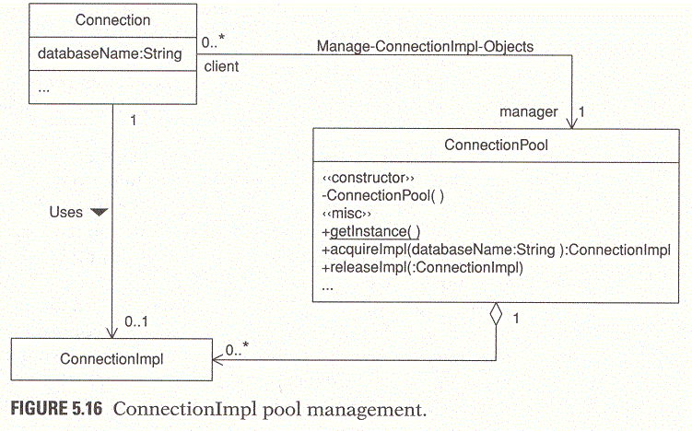
Example: DB Connection Pool

Slide 40
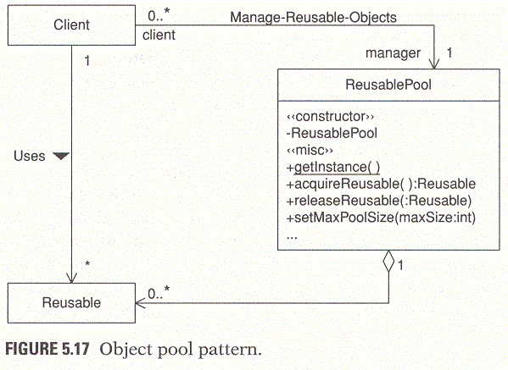
Solution

Slide 41
Consequences
Object pool works best when the demand for objects does not vary greatly over time

Slide 42
Implementation
Data structure of the object pool
  Array: when there is a limit on the number of objects that may be created
  Vector: when there is no limit on the size of the object pool

